Slide 1
Happy MONDAY! Take Out:
Pencil & Device
PLANNER
You can start work on your Google Slide, we’ll finish them today!

Slide 2
Take Out:
Pencil & Device
Not collecting the homework so keep it in your Folder

Slide 3
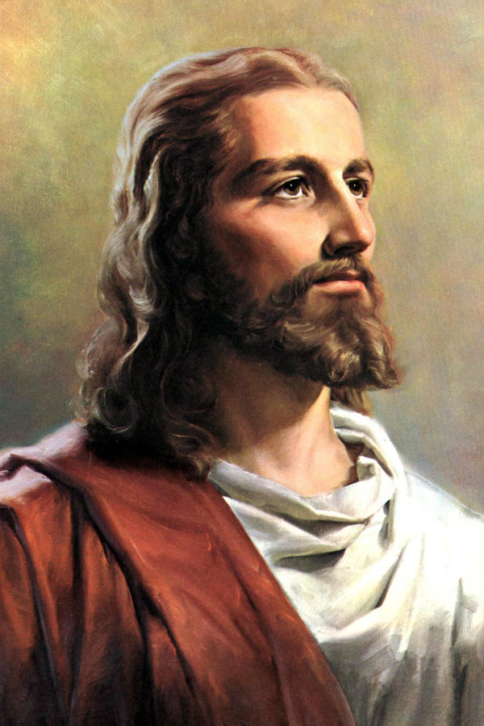
B.C. versus A.D.
B.C. = Before Christ
Jesus Christ lived about 32 years beginning in 1 A.D.

Slide 4
B.C. versus A.D.
A.D. = AFTER DEATH
ANNO DOMINI
This is a Latin term for “IN THE YEAR OF OUR LORD”

Slide 5
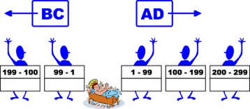
B.C. versus A.D.
B.C. is the same as B.C.E.
Before the Common Era
A.D. is the same as C.E.
Common Era

